Slide 1
Teaching at a Distance in Interesting Times
Thomas E. Love, Ph.D.
CWRU MPH Retreat – 2020-07-08
Thomas.Love@case.edu
github.com/THOMASELOVE/MPHRetreat2020

Slide 2
Teaching at a Distance in Interesting Times
Why are these interesting times?
My experiences teaching at CWRU and where I was on 2020-03-01.
Immediate Reactions (2020-03-12 and the next week or so)
Longer-Term Changes (rest of semester) and what the students said
What about the Fall?
github.com/THOMASELOVE/MPHRetreat2020

Slide 3
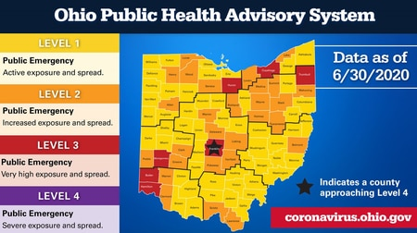


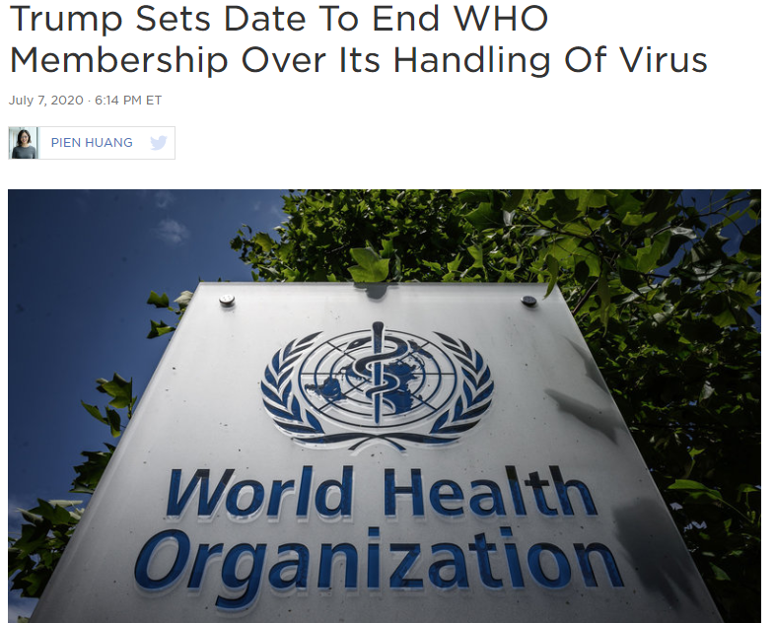


Why are these interesting times?
github.com/THOMASELOVE/MPHRetreat2020

Slide 4
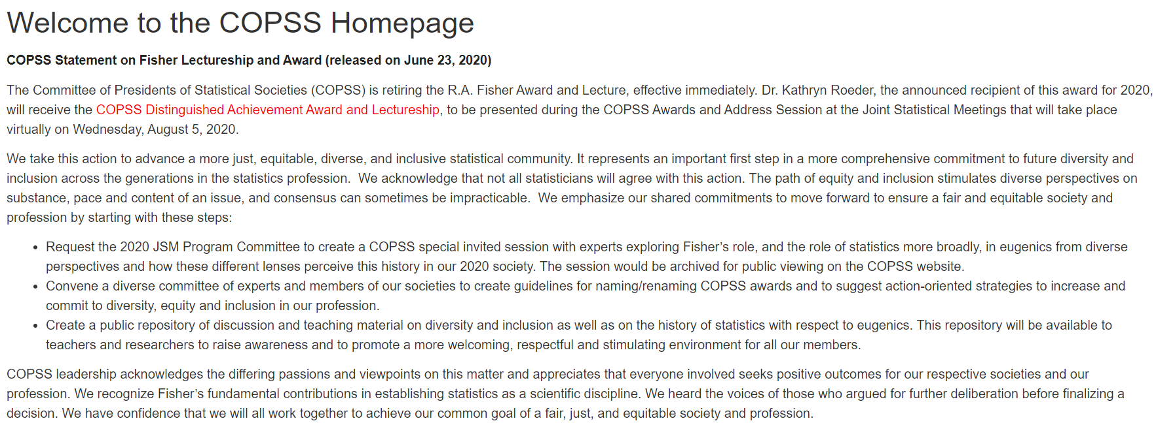
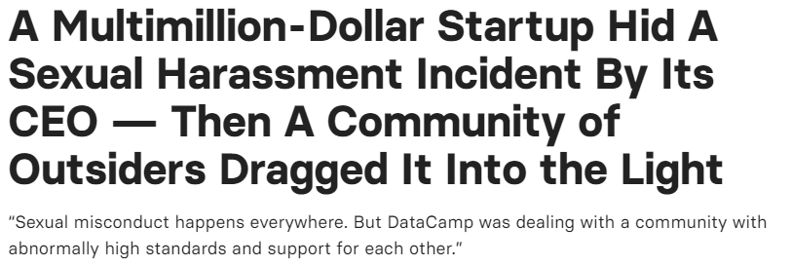
github.com/THOMASELOVE/MPHRetreat2020

Slide 5

Why are these interesting times?
github.com/THOMASELOVE/MPHRetreat2020

Slide 6
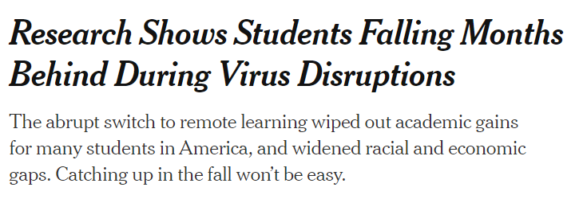
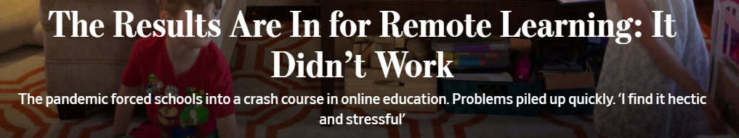
Why are these interesting times?
github.com/THOMASELOVE/MPHRetreat2020

Slide 7
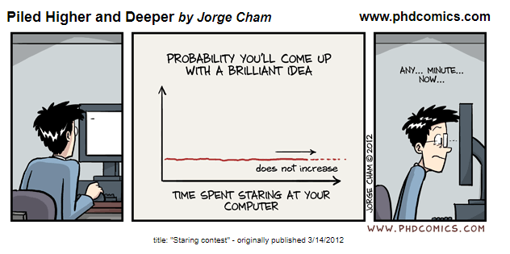

Slide 8
Expectations: Challenge or Opportunity?
Teaching at a distance will not be as effective or efficient as what you’ve done in the past.
You (and your students) are going to get frustrated
Teaching at a distance is demanding, hectic and stressful
Seeing how engaged our students are is harder
The technology is not foolproof
“The new normal” is not a comforting thought
Remote learning: “quick, ad hoc low-fidelity mitigation strategy”
Embracing variation is both more necessary and harder now
github.com/THOMASELOVE/MPHRetreat2020

Slide 9
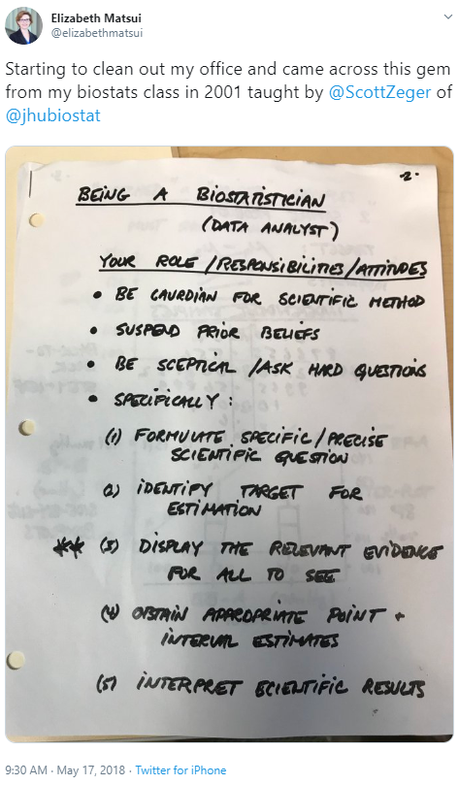
Teaching at CWRU
“Write the final exam first.”
What are the fundamental things I’m trying to get the students to have in mind?
Principles that are intellectually interesting and functionally valuable
My Classes
Intro 431-432 Course (2 semesters, ~75 students)
Observational Studies (Spring, ~ 20 students)
MPH/ MS / PhD /K trainees / Staff / BS
github.com/THOMASELOVE/MPHRetreat2020

Slide 10
What I Used to Teach in Intro Courses (and think I was doing well…)
Statistical Methods for Biological/Clinical/Medical Research
And as many different methods as I could cover in the available time…
Null hypothesis significance testing is here to stay.
Learn how to present your p value so it looks like what everyone else does
Think about "statistically detectable" rather than "statistically significant"
Don't accept a null hypothesis, just retain it.
Use point and interval estimates in the way that I do
Power is basically a hurdle to overcome in a grant application
Use Bayesian approaches / simulation / hierarchical models when they seem appropriate or for “non-standard” designs
But look elsewhere for people to teach/do that stuff
github.com/THOMASELOVE/MPHRetreat2020

Slide 11
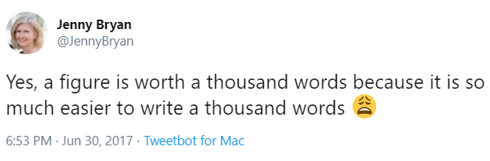
What I Think I’ve (re-)Learned from Better Health Partnership
Understanding the subject from outside of my expertise - explaining your science to audiences you never interact with - understanding more than just the jargon of my field
Visualization is most of the analytic job (scatterplots/dashboards/maps)
Importance of transparency
Importance of reproducibility
Maintaining a reporting system
Dealing with “political” considerations
Helping a student figure out what they can do now to feel/be useful while producing meaningful end-products
github.com/THOMASELOVE/MPHRetreat2020

Slide 12
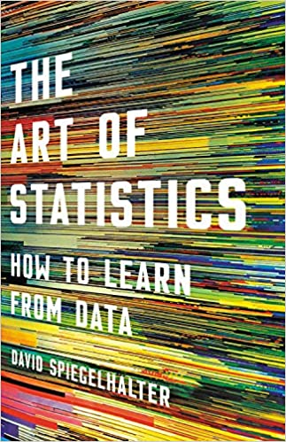
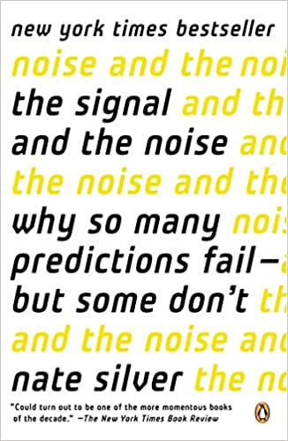
What I Aim For Now
Statistical Thinking, Data Science and Communication
Building replicable research projects with open source tools
Teaching as an Experience Creation activity.
Learners have to generate things on their own.
Students should make lots of little mistakes…
What is the question you are trying to answer with this design?
When stuck in a design, I think about how to get better data.
When stuck in an analysis, I try to turn a table into a graph. (J. Bryan)
Which method is far less important than finding better data
The biggest mistake we make regularly is throwing away useful data.
“If the research question is important, the result is important. Whatever it is.” (P. Wakim)
github.com/THOMASELOVE/MPHRetreat2020
https://github.com/THOMASELOVE/rethink for details and sources

Slide 13
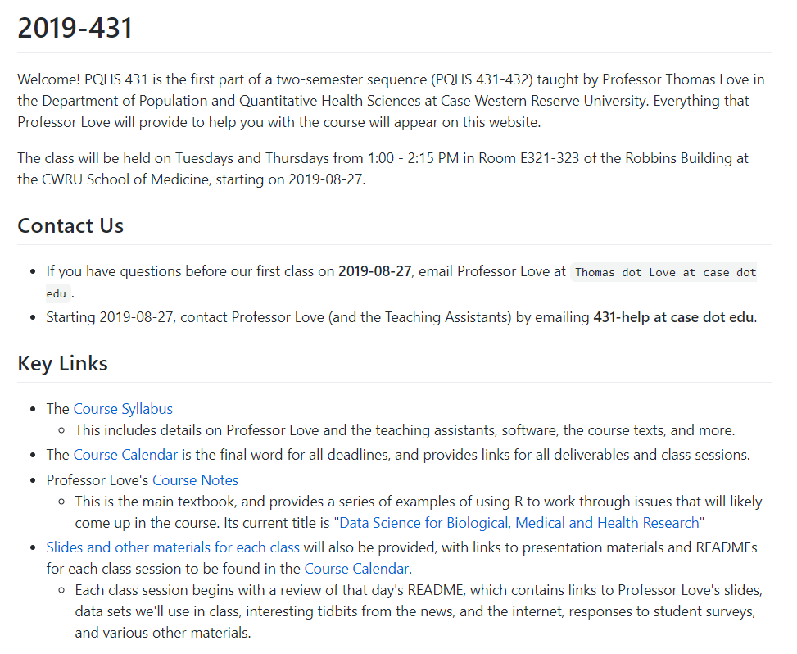
github.com/THOMASELOVE/MPHRetreat2020

Slide 14
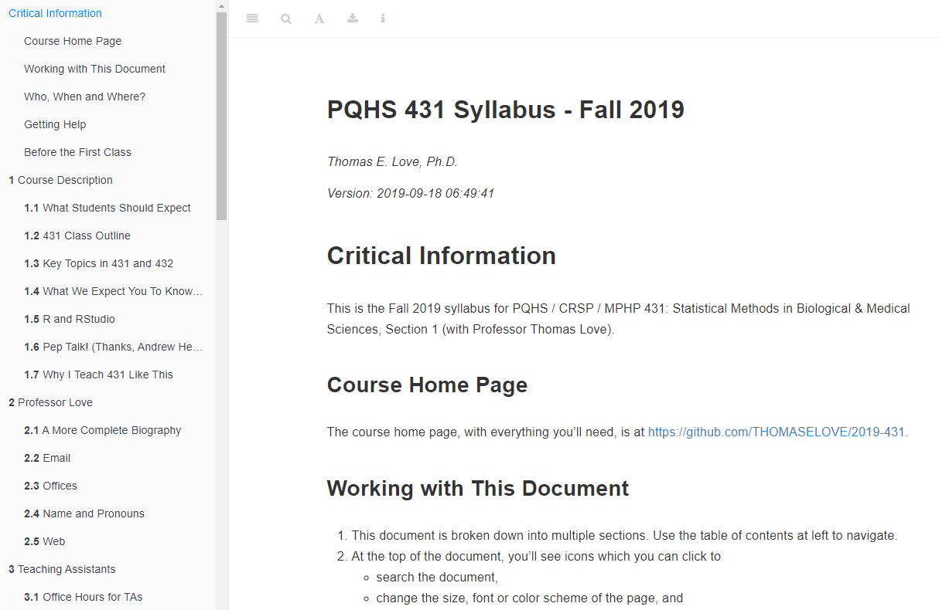
github.com/THOMASELOVE/MPHRetreat2020

Slide 15
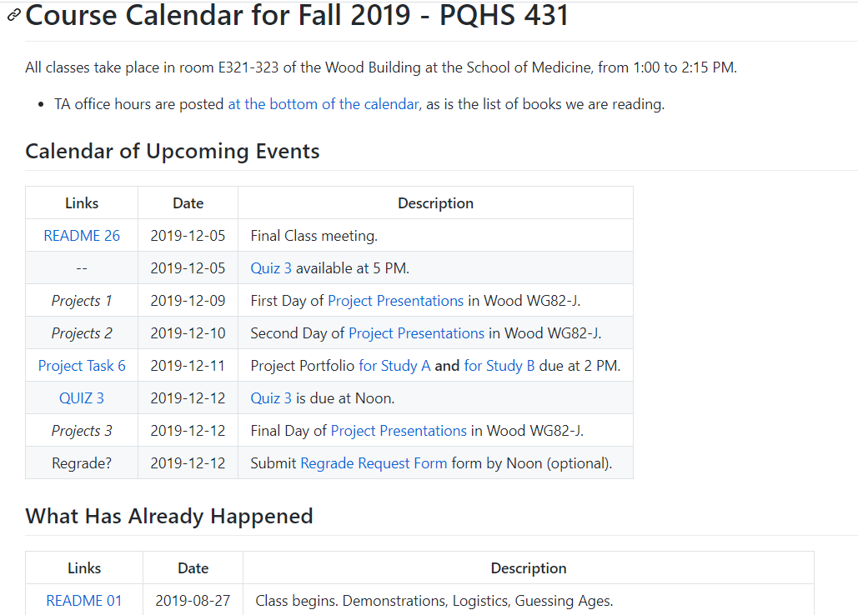
github.com/THOMASELOVE/MPHRetreat2020

Slide 16
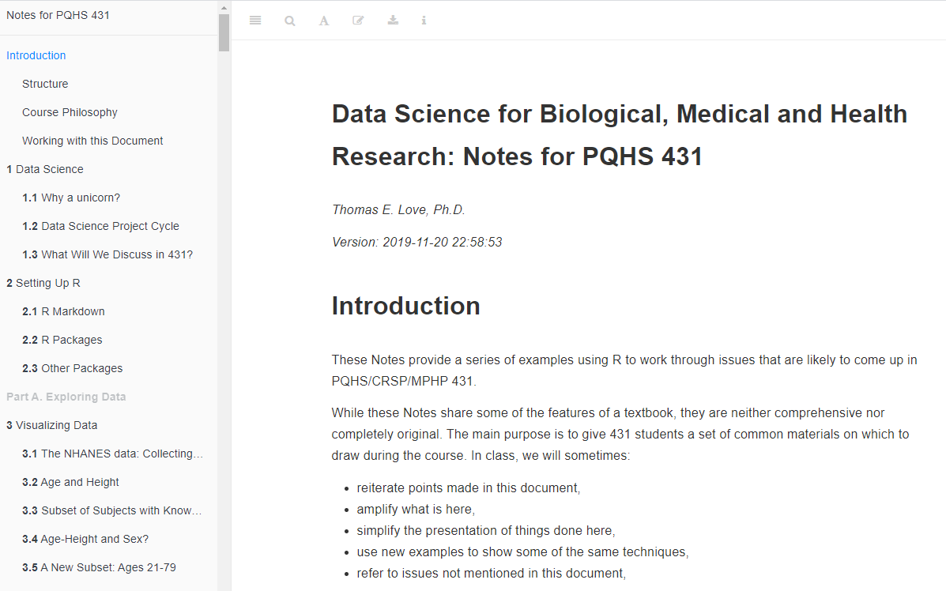
github.com/THOMASELOVE/MPHRetreat2020

Slide 17
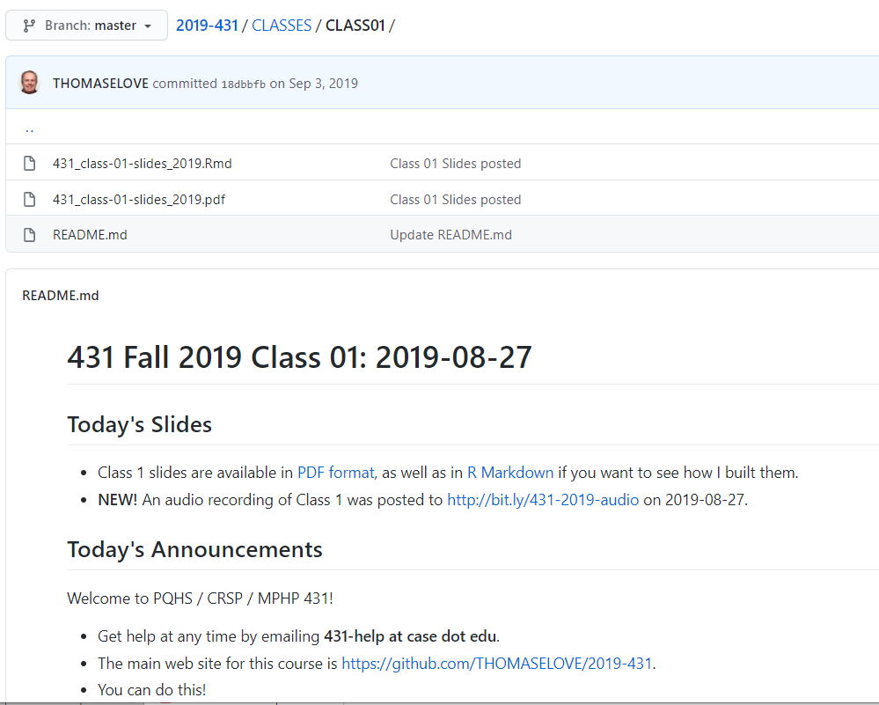
github.com/THOMASELOVE/MPHRetreat2020

Slide 18
What I most enjoy doing (probably) isn’t especially effective.
Students like my courses, and that’s great, but many of the comments quoted describe how much the courses cover.
Most students don’t learn all that well from watching me do things
More learn more by making mistakes in non-critical situations (R. Duke)
Encourage students to think about problems systematically? (J. Hardin):
What did you do?
Why did you do it?
What is the next step?
What do I still not understand?
github.com/THOMASELOVE/MPHRetreat2020

Slide 19
Five Things That I Think Work (at least for My Current Students)
2020-03-01
READMEs at the start of each class
Slides/Code/Announcements/Things In The News/One Last Thing
Remove some pain points in the introduction to Github repositories
Teaching Assistants and 431-help/500-help
Mix of compensated folks and volunteers each year
Grading is tough - the right answer is a poor indicator of understanding.
Development of answer sketches and rubrics for homework
24/7 help, but make them ask good questions / reproducible examples
Minute Papers (electronically, with multiple feedback layers)
3 questions I ask every time + something fun/current/course-specific
github.com/THOMASELOVE/MPHRetreat2020

Slide 20
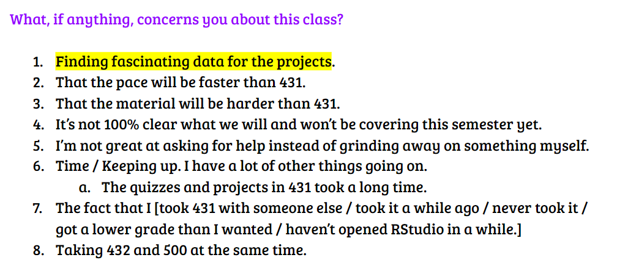
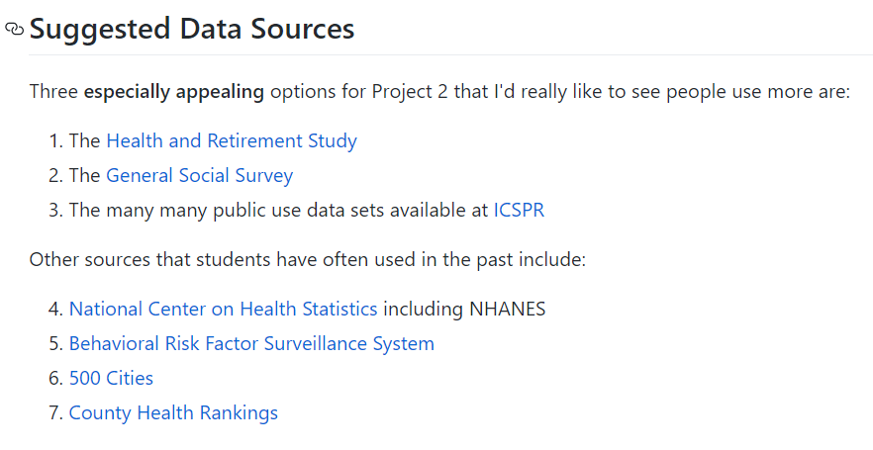
Minute Paper after Class 1 (432 – Spring 2020)
https://github.com/THOMASELOVE/2020-432 (project 2 instructions)
github.com/THOMASELOVE/MPHRetreat2020

Slide 21
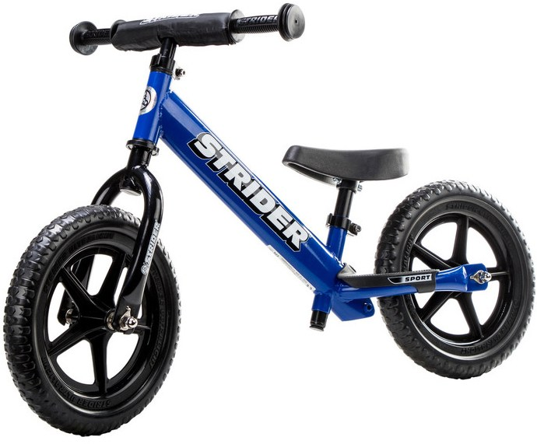
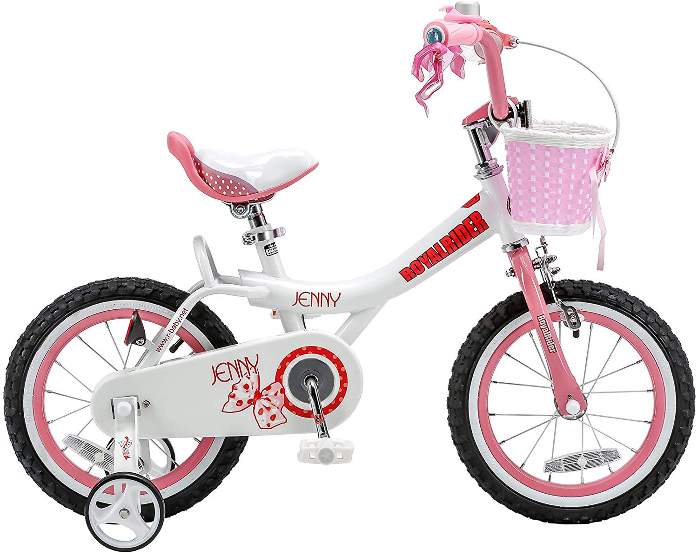
Five Things That I Think Work (at least for My Current Students)
2020-03-01
At least two detailed examples for everything
One in-class with discussion and demonstration
One out-of-class (asking questions / building code)
Supplemented by regular, low-stakes homework
Projects as the culminating event
Proposal – Update – Final stages
Establish the research questions, build a soup-to-nuts proposal, find then ingest data, do the analyses, present the results
1 on 1 Portfolio presentations + Midway peer sessions
“Research Team meetings”, Posters, Slides, .Rmd + HTML
Templates as “training wheels” (R. Duke)
github.com/THOMASELOVE/MPHRetreat2020

Slide 22
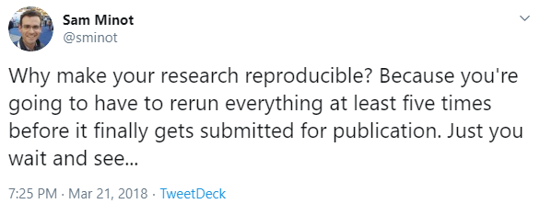
Ten Simple Rules for Effective Statistical Practice Robert E. Kass, Brian S. Caffo, Marie Davidian, Xiao-Li Meng, Bin Yu, Nancy Reid
Make Your Analysis Reproducible
Your closest collaborator is you, six months ago, but you don’t answer emails. (Paul Wilson, via Karl Broman)
PLOS Computational Biology 2016 12(6): e1004961 (Ten Simple Rules)
Steps towards Reproducible Research (Karl Broman)
github.com/THOMASELOVE/MPHRetreat2020

Slide 23
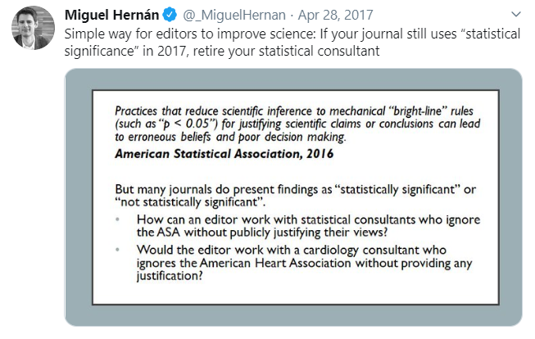

Slide 24
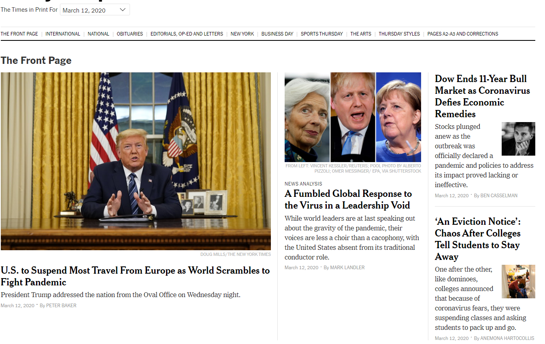
github.com/THOMASELOVE/MPHRetreat2020

Slide 25
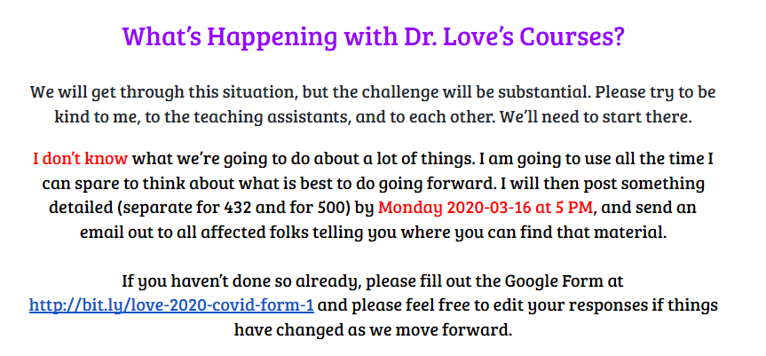
2020-03-12
github.com/THOMASELOVE/MPHRetreat2020

Slide 26
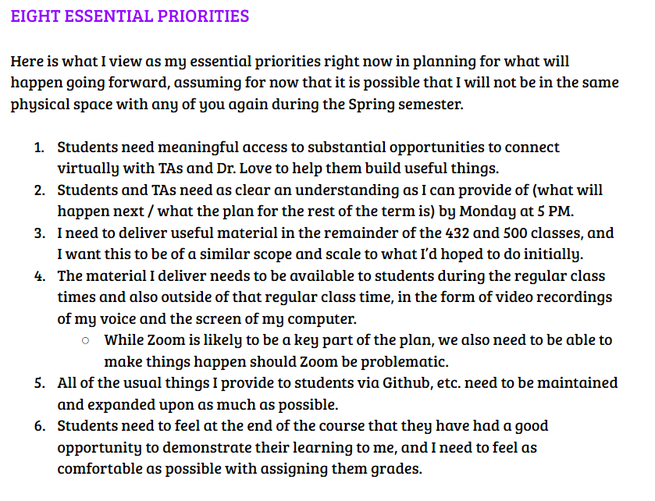
github.com/THOMASELOVE/MPHRetreat2020

Slide 27
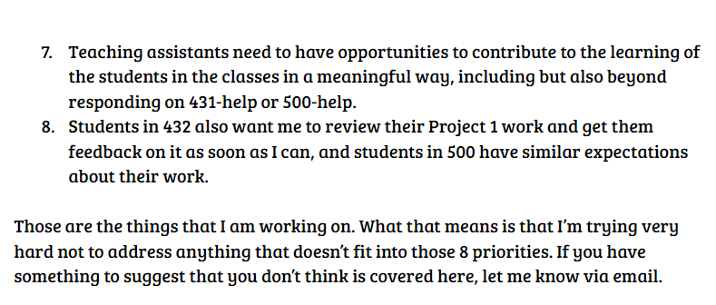
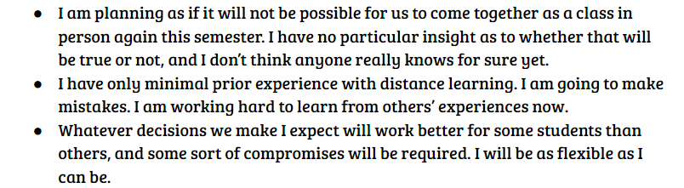
github.com/THOMASELOVE/MPHRetreat2020

Slide 28
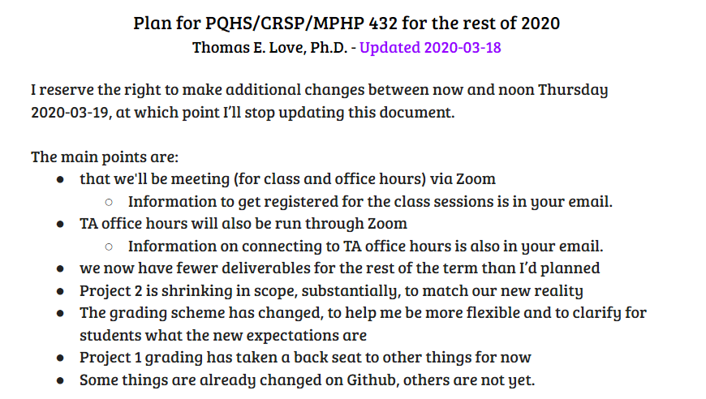
Google Doc and Email, Slide 1
github.com/THOMASELOVE/MPHRetreat2020

Slide 29
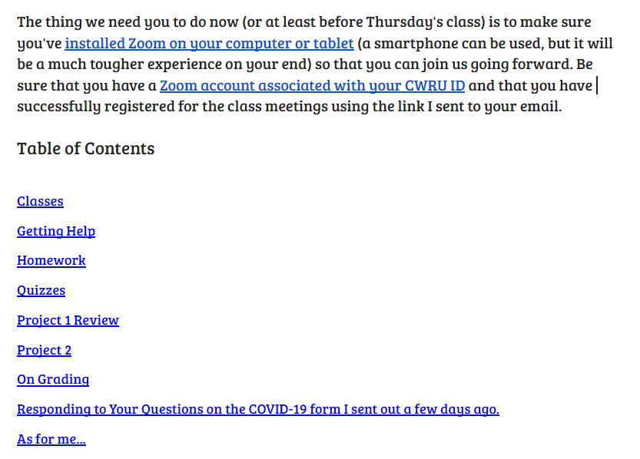
Google Doc and Email, Slide 2
github.com/THOMASELOVE/MPHRetreat2020

Slide 30
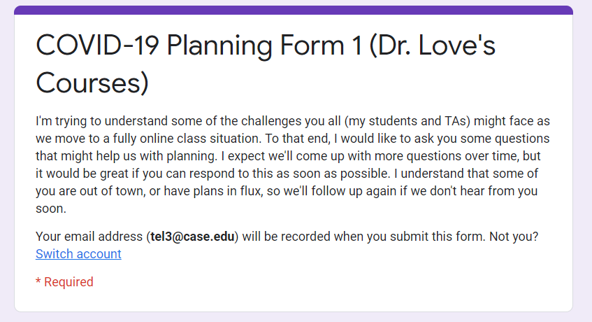
http://bit.ly/love-2020-covid-form-1
github.com/THOMASELOVE/MPHRetreat2020

Slide 31
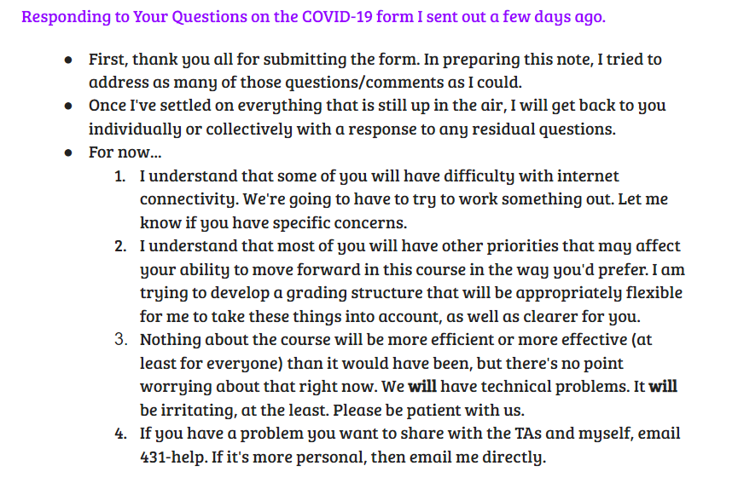
github.com/THOMASELOVE/MPHRetreat2020

Slide 32
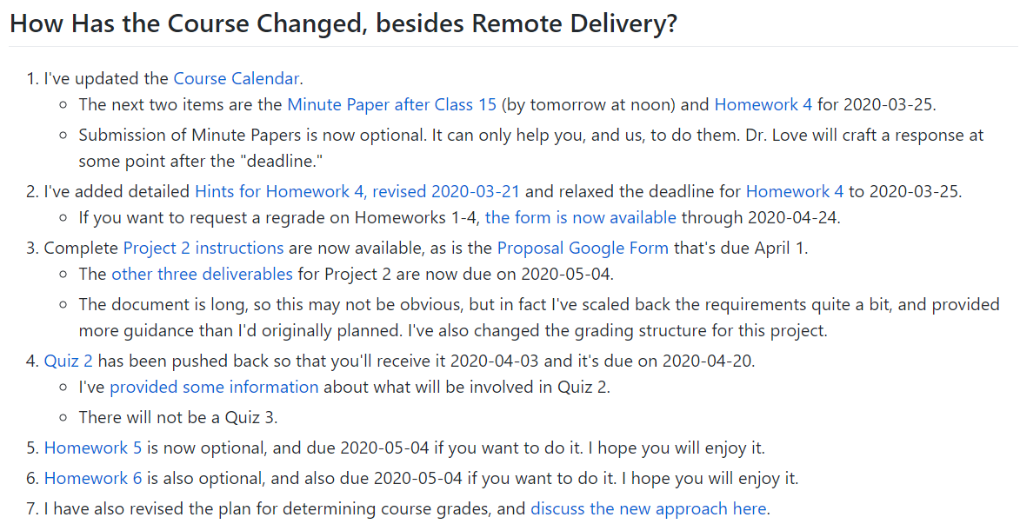
github.com/THOMASELOVE/MPHRetreat2020

Slide 33
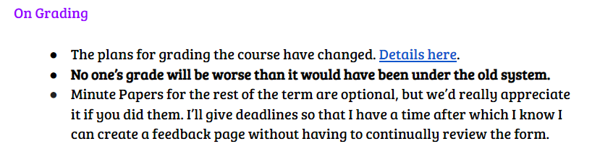
github.com/THOMASELOVE/MPHRetreat2020

Slide 34
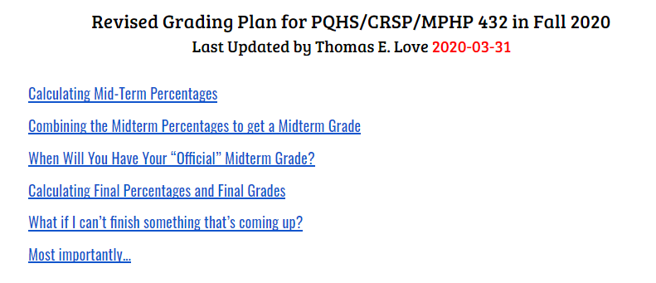
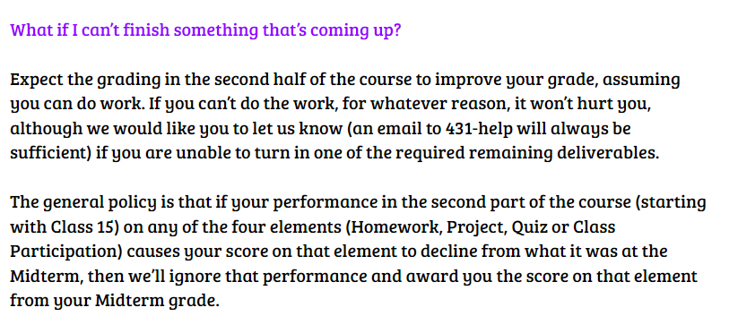
github.com/THOMASELOVE/MPHRetreat2020

Slide 35
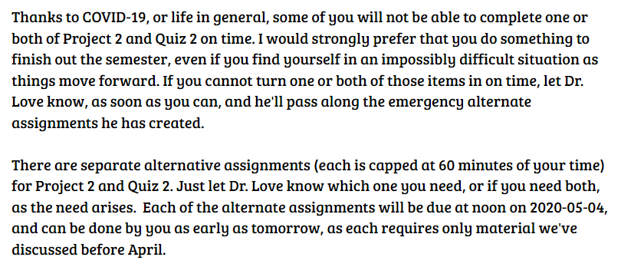
github.com/THOMASELOVE/MPHRetreat2020

Slide 36
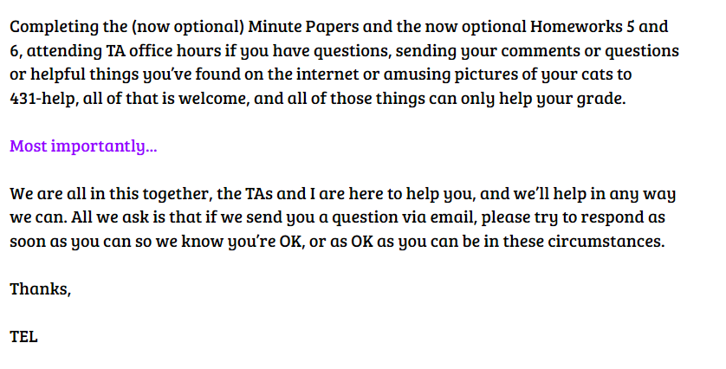
github.com/THOMASELOVE/MPHRetreat2020

Slide 37
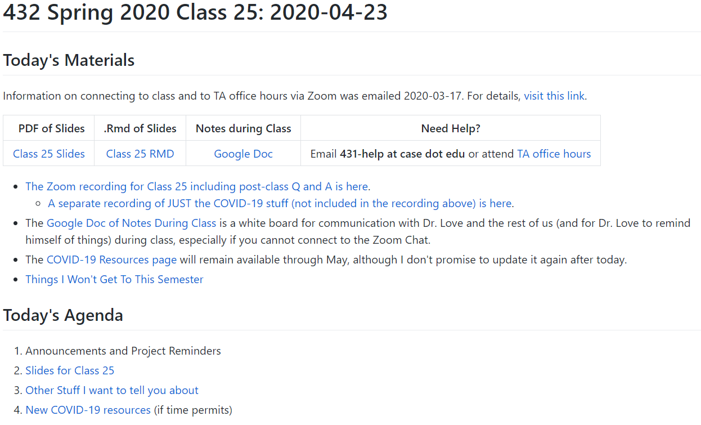
github.com/THOMASELOVE/MPHRetreat2020

Slide 38
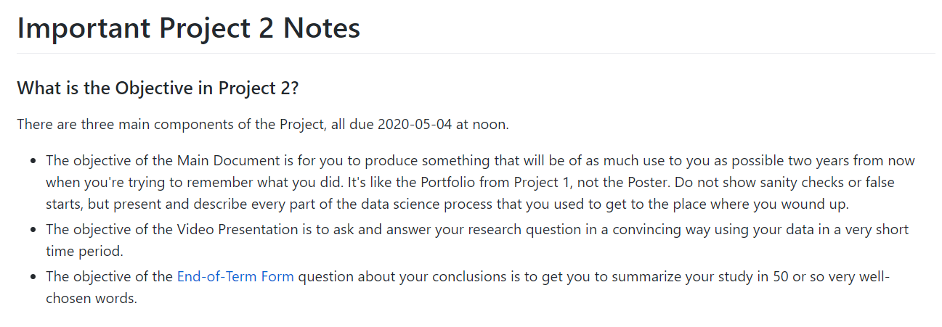
github.com/THOMASELOVE/MPHRetreat2020

Slide 39
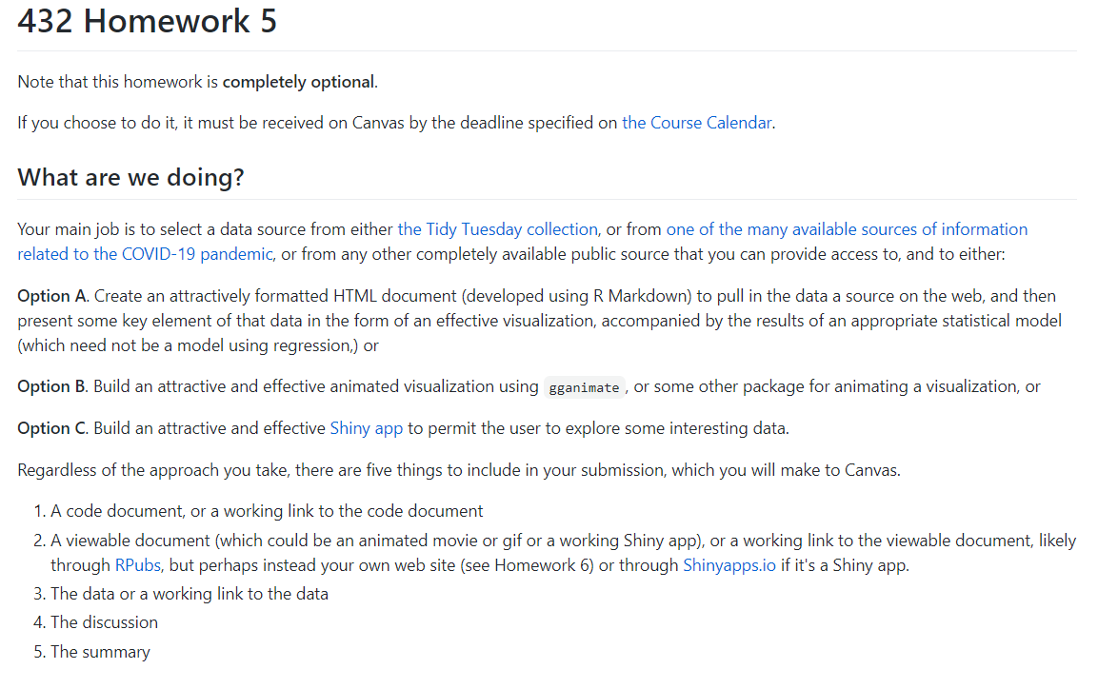
github.com/THOMASELOVE/MPHRetreat2020

Slide 40
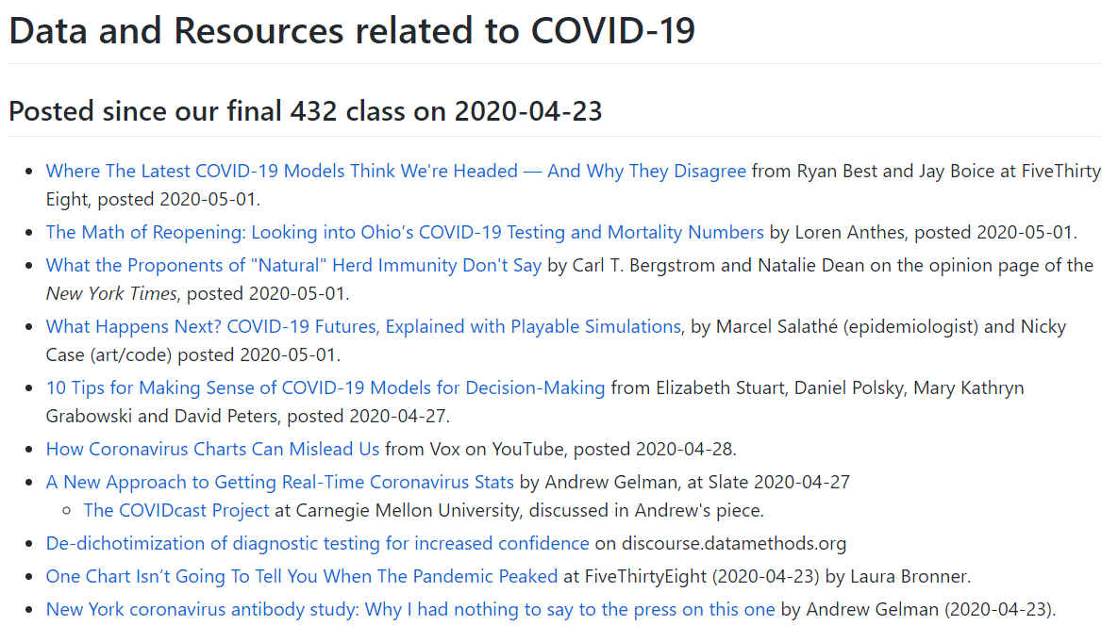
https://github.com/THOMASELOVE/2020-432/blob/master/covid19resources.md

Slide 41
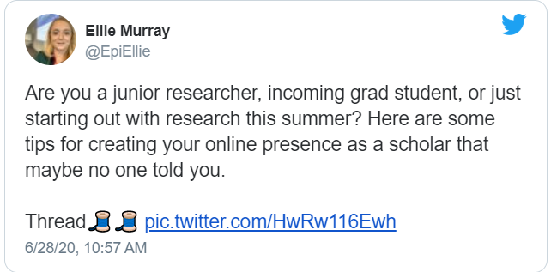
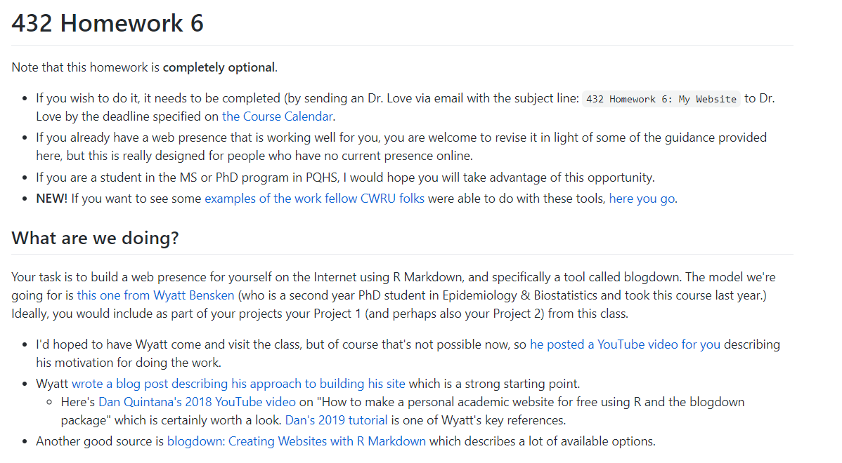
github.com/THOMASELOVE/MPHRetreat2020

Slide 42
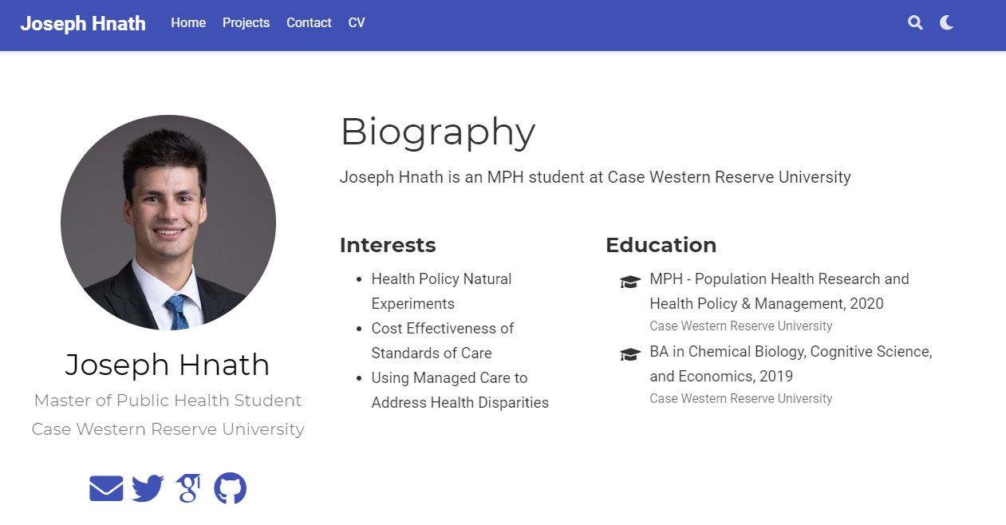
https://josephhnath.netlify.app/

Slide 43
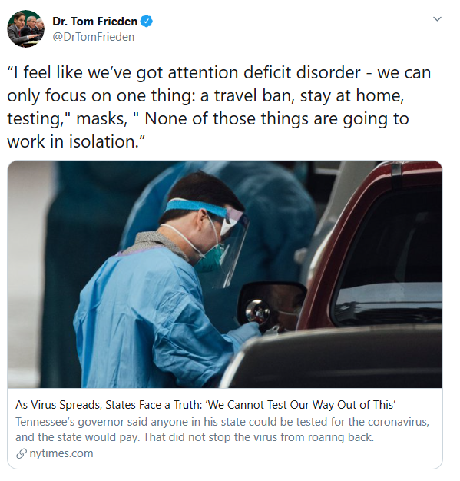
What about the Fall?

Slide 44
What about the Fall?
75+ students in the 431 course, so it will be remote only
My opinion: plan for remote only whether we (students) like it or not
More intensive opportunities to interact with me as well as TAs
My usual class survey to be supplemented with Zoom videos, etc.
How do I do intensive projects with 75+ instead of 50 students?
I’m working at getting better at technical niceties of Zoom, etc.
And I’m upgrading my own website (Github), mic, lighting, zoom background
Looking at additional technology tools to improve Canvas experience (Piazza?)
Windows and Mac people need help and they need it early from you
Lots of things have changed in the past year in terms of interesting relevant work (ASA Statements on p values, rising availability of Bayesian tools in R for modeling, intense interest in COVID-19 visualizations and in the upcoming US elections)
github.com/THOMASELOVE/MPHRetreat2020

Slide 45
What about the Fall?
What can students/TAs do in the summer to feel more prepared?
What can I do to reduce anxiety and increase certainty in diverse students?
How do we identify / help students at a distance who are struggling?
How can I get to know enough about these students and their concerns in the early stages of the course? How will they connect to other students?
How can I help students learn about the (checkered) history of my field?
How do I keep people interested in learning with data?
Improving my assignments first, then focusing on changes to content
Multiple delivery schemes for the students to turn in work
Old assignments to be made public, since they are already
Drop more than you add – this is a less efficient way to present new ideas
This is a great time to try new ways to engage students but only if you can react to their feedback and have tools in place to receive it
github.com/THOMASELOVE/MPHRetreat2020

Slide 46
What is important to me, going forward…
Build programs: educate the next generation of health data scientists
Learn to do data science / think / design / program / communicate clearly.
Use data more deeply to improve my teaching of data science.
Reduce further my reliance on high-stakes infrequent assessment.
Causal methods as a more meaningful part of intro curricula.
Get more connected to people doing this work elsewhere.
Mentoring other educators, rather than just helping to write curricula.
Get back to statistics education research. (eCOTS 2020: Engaging everyone)
Focus on working with useful health data and on interventions / ideas that can be shared with the world.
Build on the preliminary work we’ve done on non-medical health determinants, and on driving change through collective action.
Get more opportunities to learn from what I’m trying to do.
Work with smart people from whom I can get excited about new things.
github.com/THOMASELOVE/MPHRetreat2020

Slide 47
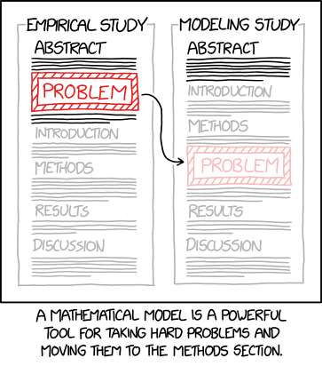
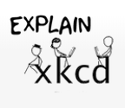
Title text: You've got questions, we've got assumptions.
https://www.explainxkcd.com
https://xkcd.com/2323/
github.com/THOMASELOVE/MPHRetreat2020

Slide 48
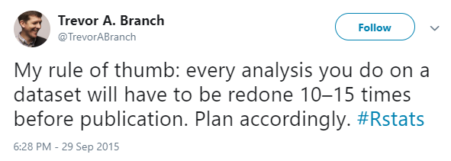
Thanks for listening…
github.com/THOMASELOVE/MPHRetreat2020

Slide 49
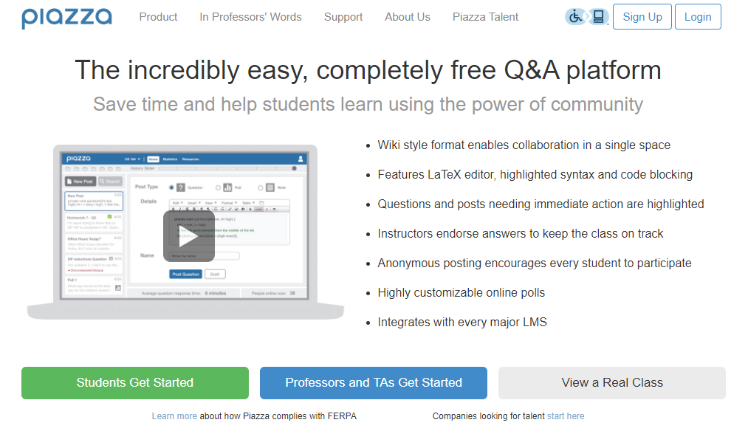

Slide 50
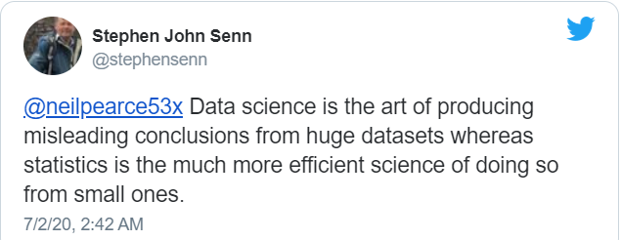



https://xkcd.com/2327 https://xkcd.com/2328 https://xkcd.com/2329 and also explainxkcd.com

